Slide 1



Implementation of Radix sort using Array
GROUP NO:-30
ROLL NO:-175-179
SYCO-C

Slide 2

1. Introduction
In the realm of sorting algorithms, Radix Sort stands tall for its unparalleled elegance and efficiency. Stemming from its systematic approach to ordering elements, this algorithm has become a cornerstone of computer science. In this formal analysis, we delve into the intricacies of Radix Sort, exploring its intuitive nature and captivating elegance.

Slide 3
2. What is Radix Sort?
Radix Sort is a non-comparative sorting algorithm that groups elements by their digits, from the least significant to the most significant. It iterates through each digit, creating multiple "buckets" to distribute the elements based on the value of the current digit. By repeatedly applying this process, Radix Sort can efficiently sort large sets of data.

Slide 4
3. How does Radix Sort work?
Radix Sort works by iteratively sorting elements based on their digits. It starts with the least significant digit and creates "buckets" to distribute the elements based on the value of the current digit. The process is repeated for each subsequent digit until the entire dataset is sorted. By exploiting the structure of the data, Radix Sort achieves efficient sorting without needing to compare elements. Its elegant design makes it a valuable tool for handling large datasets.

Slide 5
4. Time Complexity of Radix Sort
The time complexity analysis of Radix Sort reveals its efficiency in handling large datasets with a known range of values. With a complexity of O(d*n), where d is the number of digits in the largest element and n is the number of elements.

Slide 6
5. Space Complexity of Radix Sort
In addition to its time complexity, it is important to consider the space complexity of Radix Sort. Due to its use of counting and auxiliary arrays, Radix Sort has a space complexity of O(n+k), where k is the range of values

Slide 7
1. Radix sort has a linear time complexity, which makes it faster than comparison-based sorting algorithms such as quicksort and merge sort for large data sets. 2. It is a stable sorting algorithm. 3. Meaning that elements with the same key value maintain their relative order in the sorted output. 4. Radix sort is efficient for sorting large numbers of integers or strings. It can be easily parallelized.
ADVANTAGES
DISADVANTAGES
Radix sort is not efficient for sorting floating-point numbers or other types of data that cannot be easily mapped to a small number of digits.
It requires a significant amount of memory to hold the count of the number of times each digit value appears.
It is not efficient for small data sets or data sets with a small number of unique keys.
It requires that the data being sorted can be represented in a fixed number of digits, which may not be the case for some types of data.

Slide 8
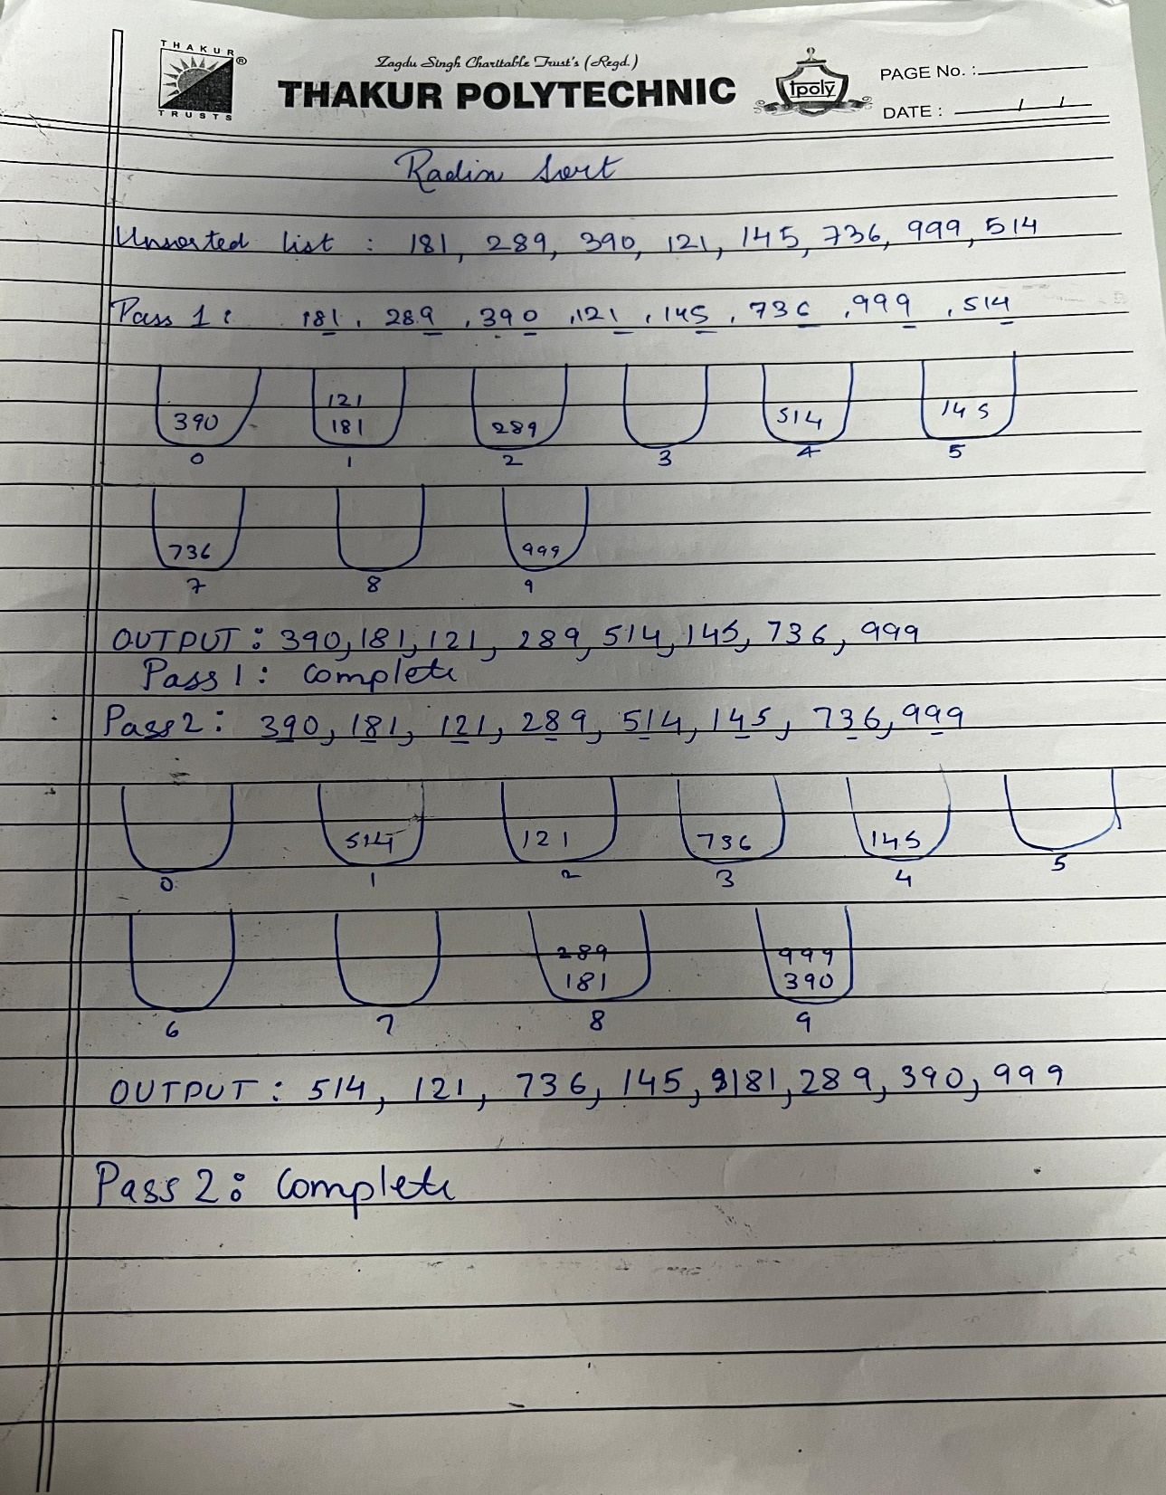
EXAMPLE FOR RADIX SORT

Slide 9
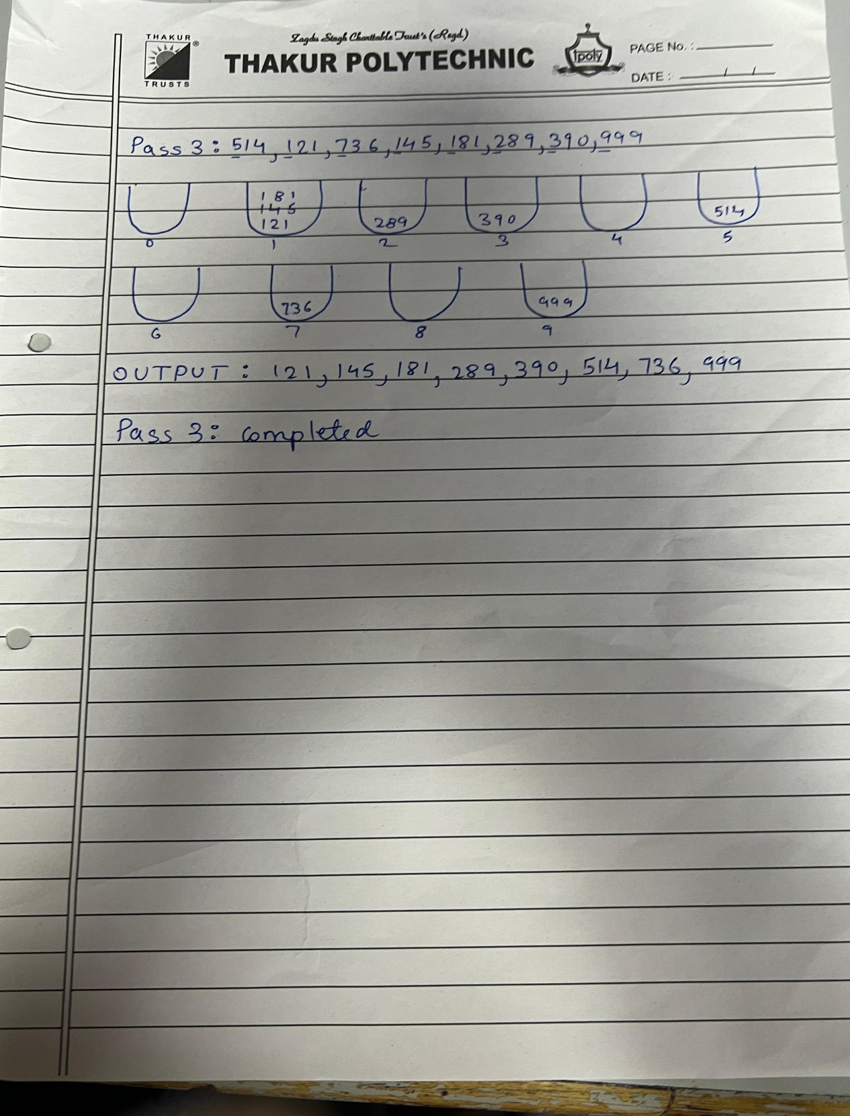
EXAMPLE FOR RADIX SORT

Slide 10
THANK YOU

